Slide 1

10th October, 2019
Speaker: Víctor Vicente

Slide 2

What is PyData?
Frequent Topics
Educational program of (a non-profit organization)
Share ideas about data analysis tools
Community-driven conference (novice to advance)
Machine Learning
Artificial Intelligence
Predictive Modelling
Data Mining
Natural Language Processing
Probabilistic Programming

Slide 3
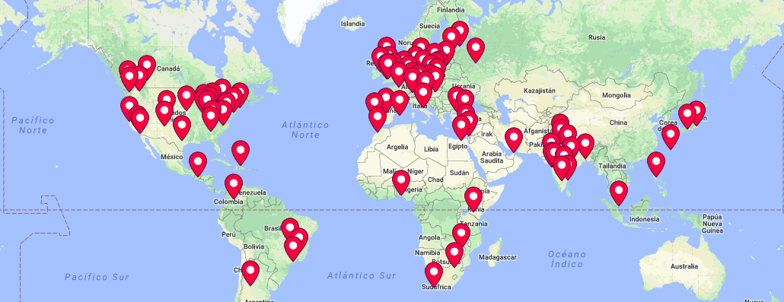
Where is PyData in 2019?

Slide 4
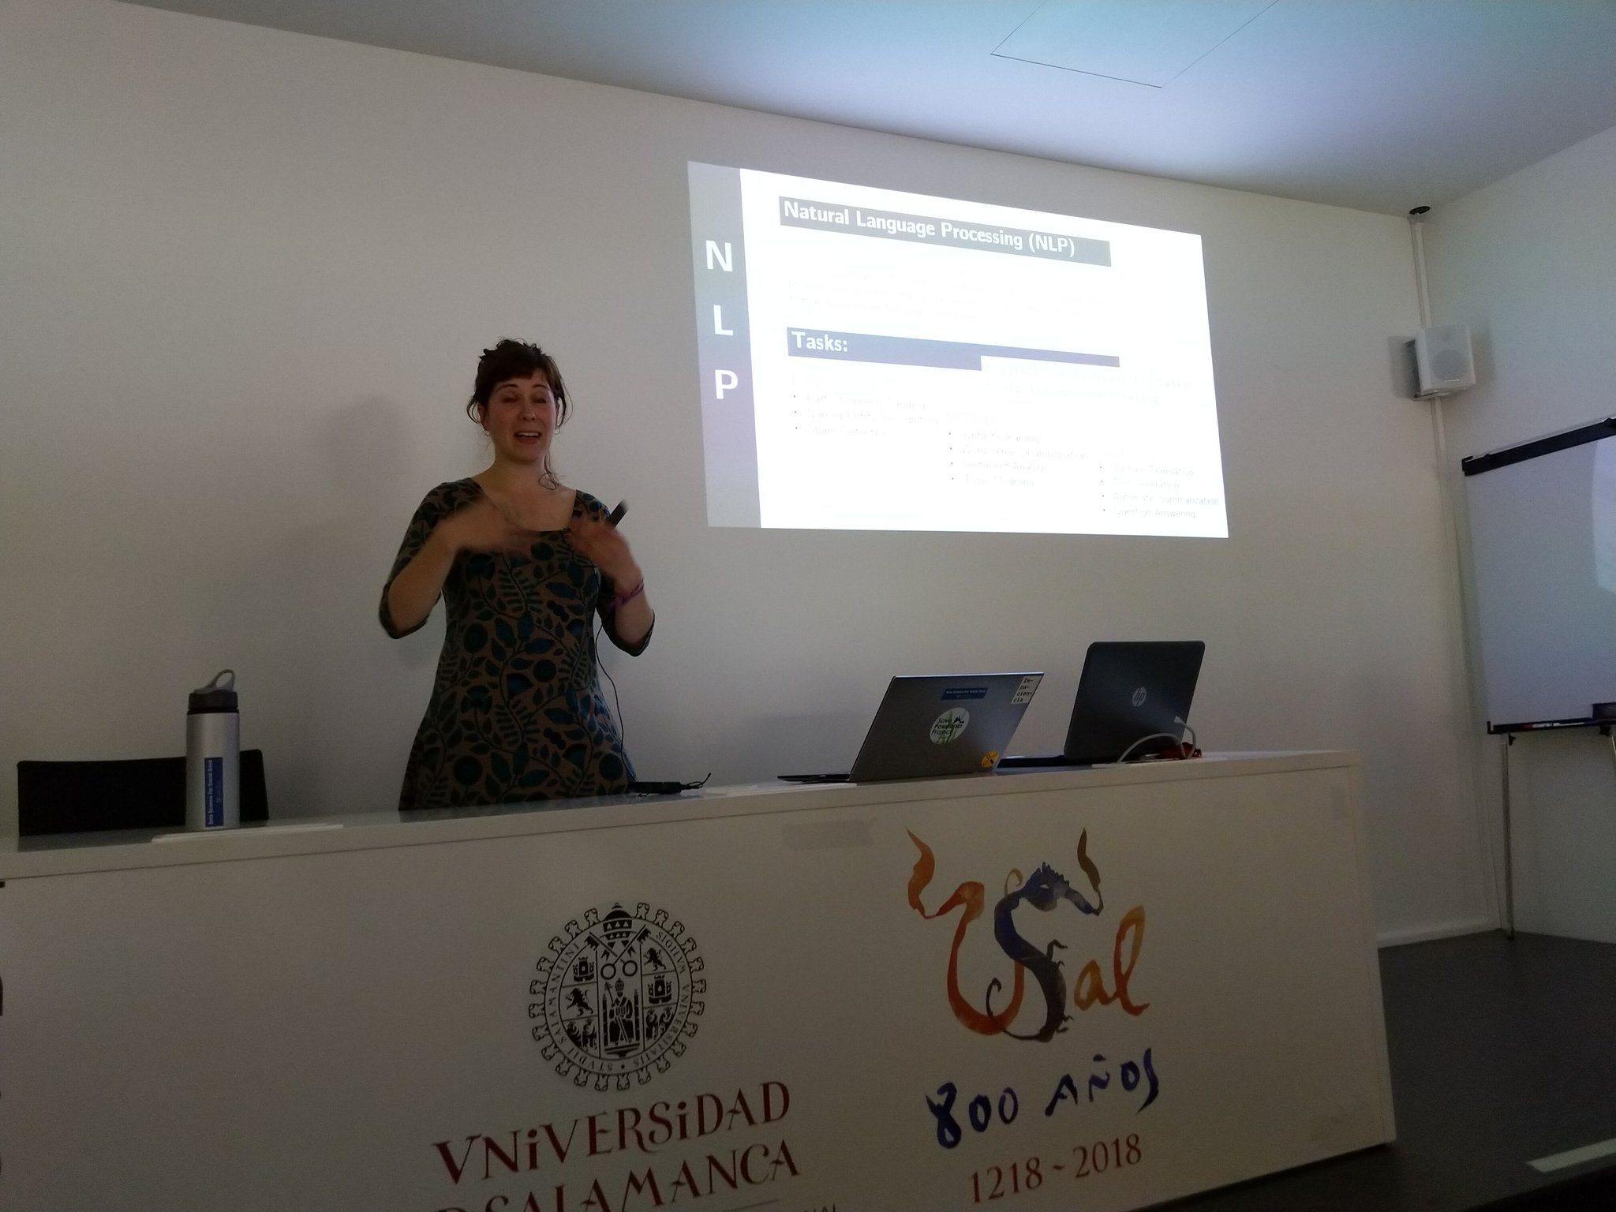
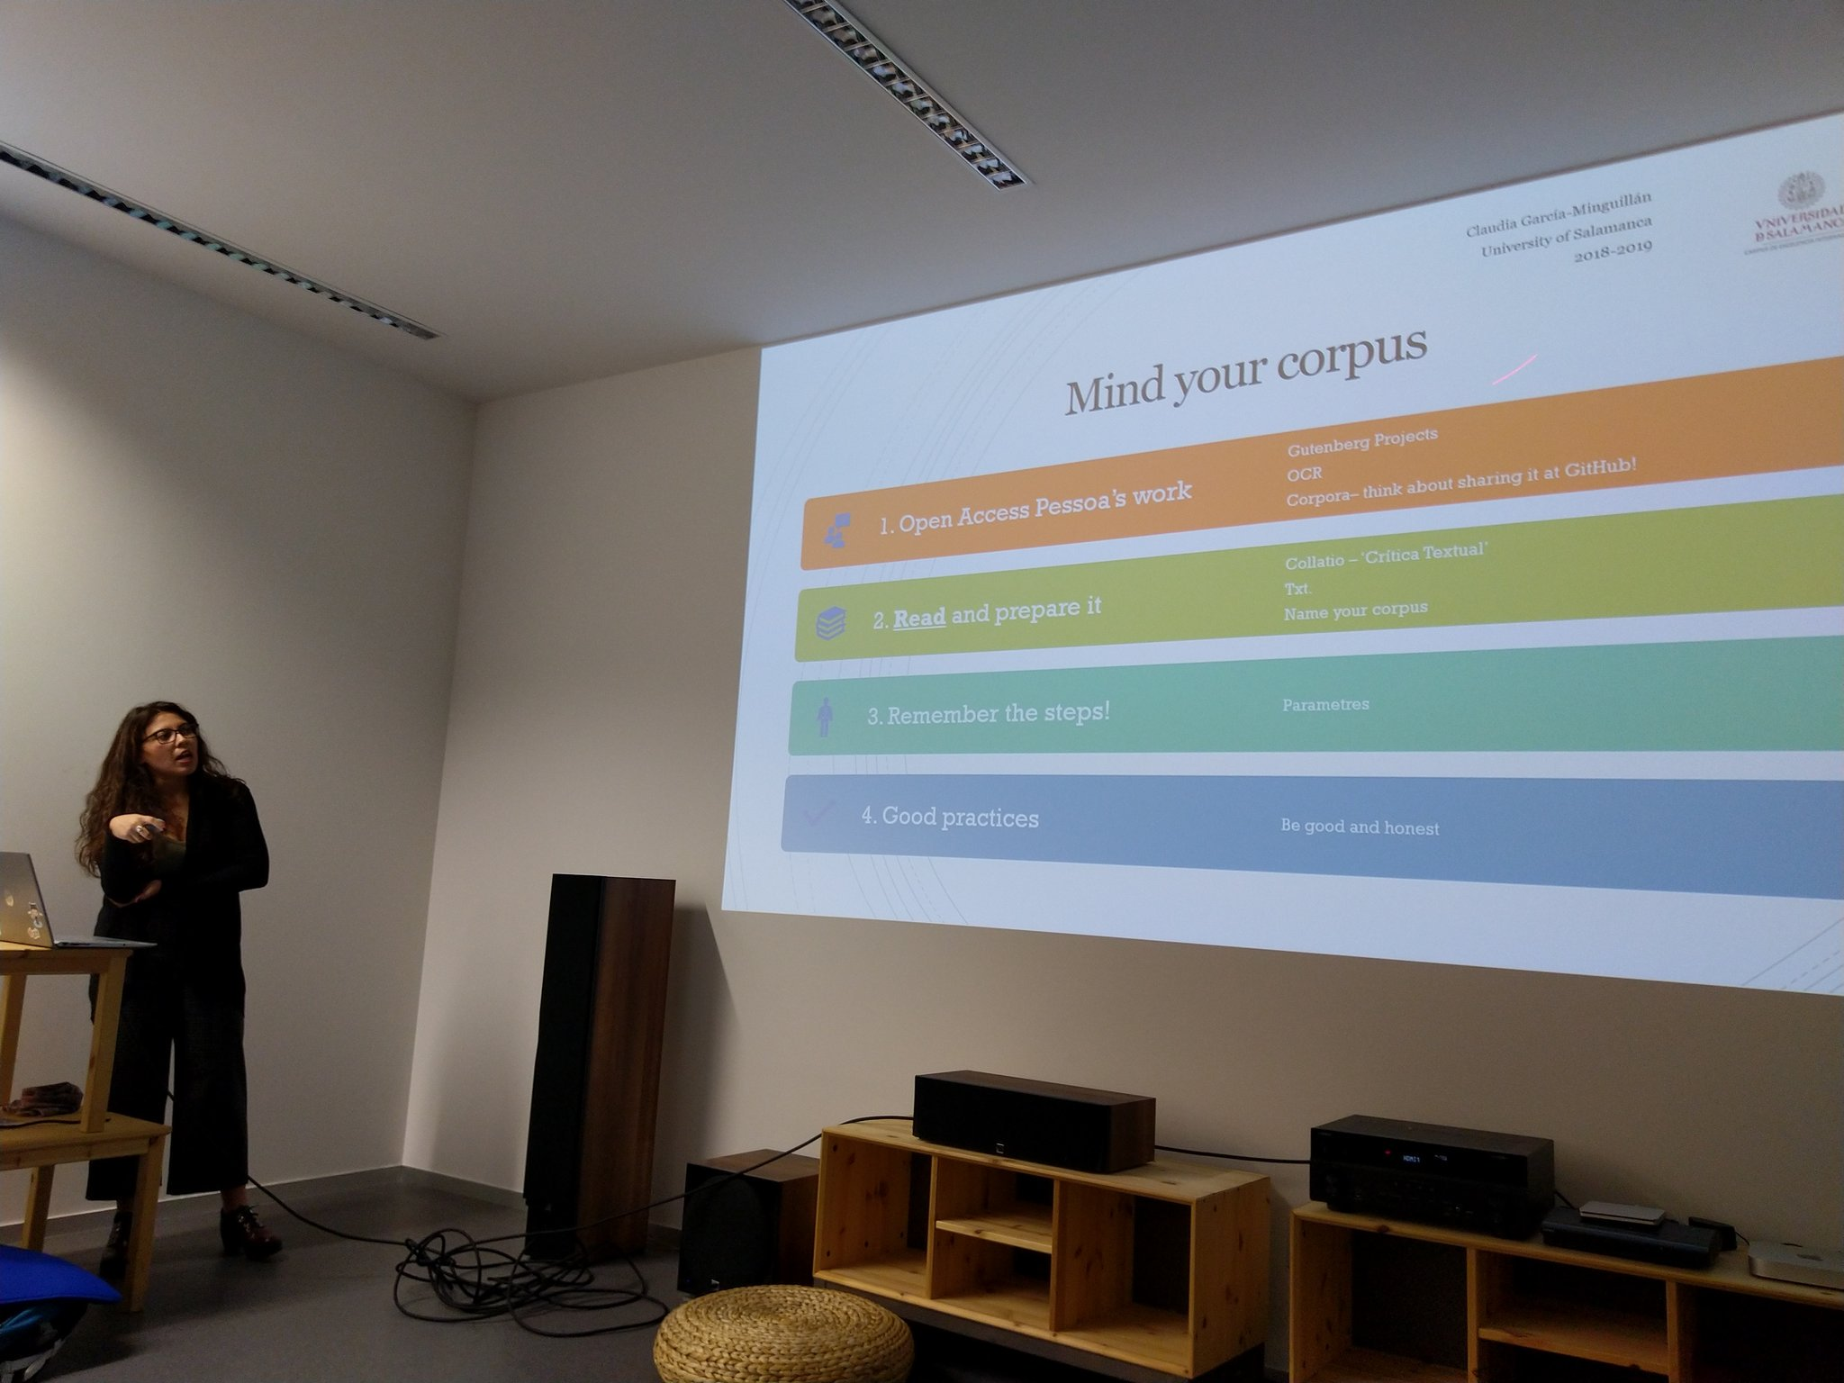
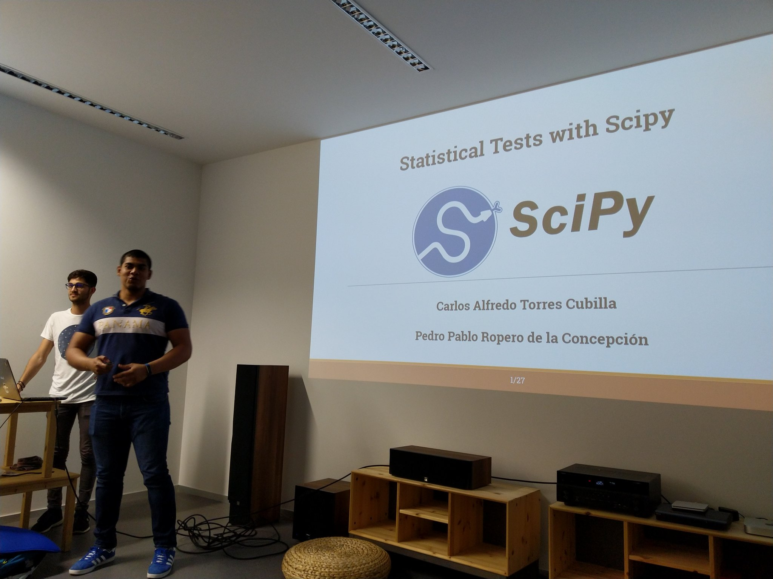
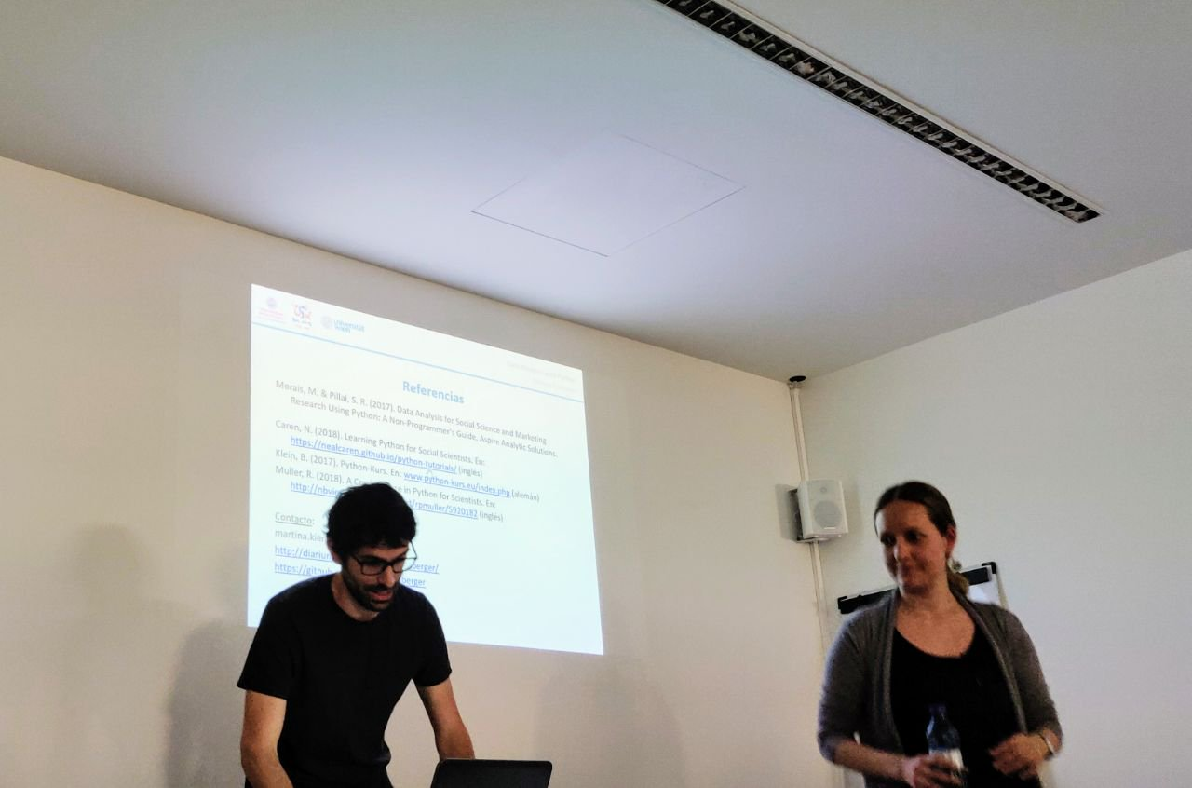
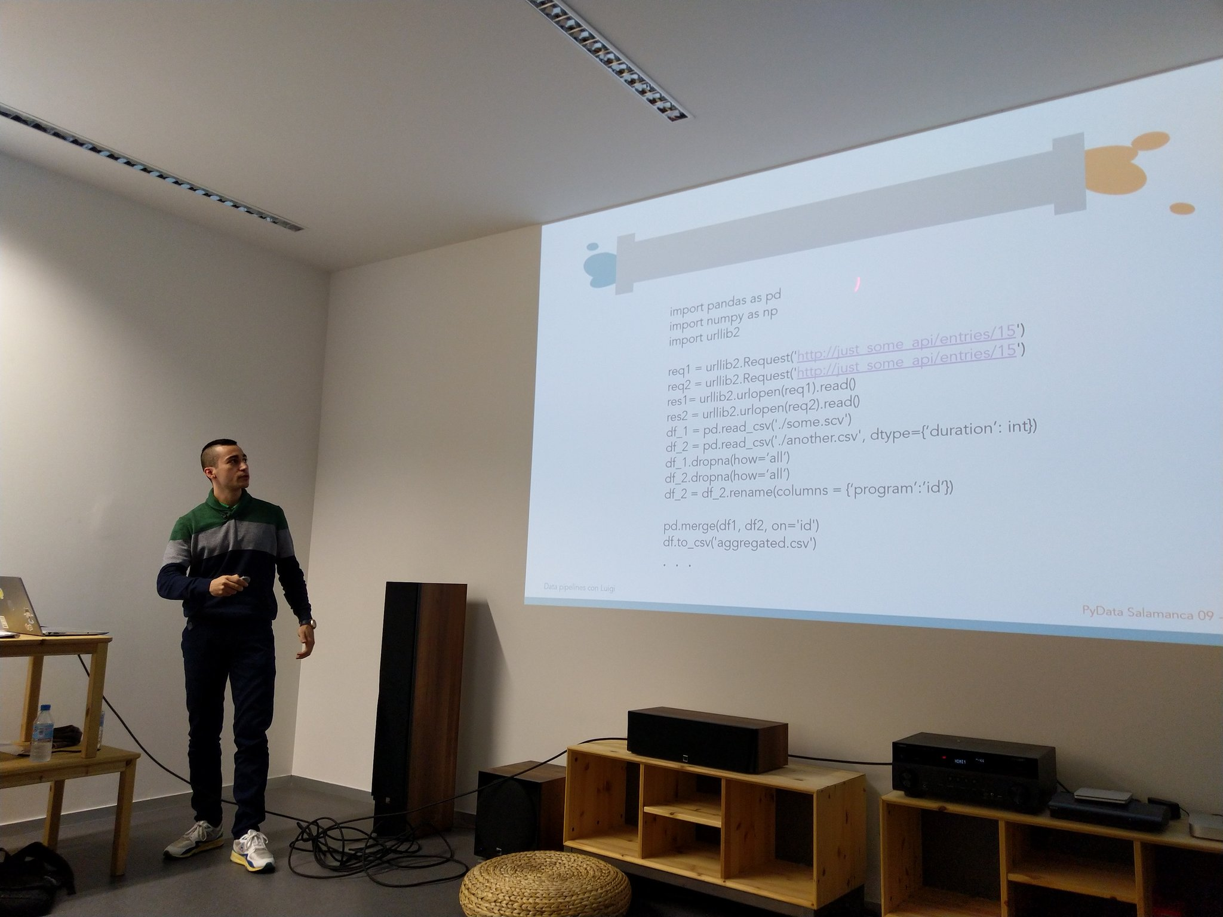
PyData SALAMANCA (1st year)
7 Talks
7 Speakers

Slide 5
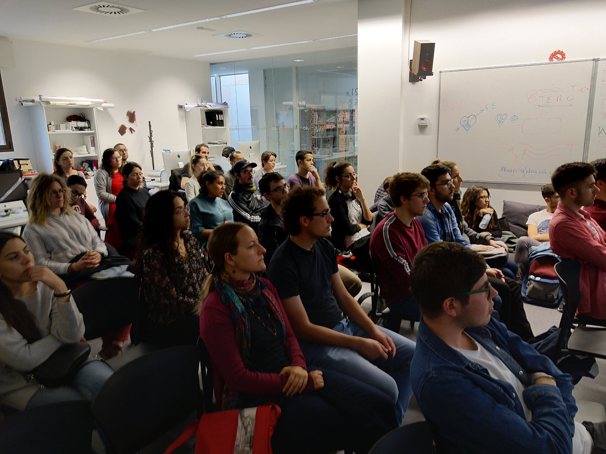
Attendance (1st year)
244 MeetUp members
184 Assistants
THANK YOU!

Slide 6

Participate!
PyData is community-driven
Share your knowledge (novice to advanced)
Propose interesting discussions
New data analysis tools? New trends?
Contact us!
victorvicpal@usal.es
- Victor @victorvicpal
- Juan @_juancb
- Chechu @scdpcgc
- Alberto @Alber_267
- Alex @alexmad09
- Gonzalo @gon99martin
- Pablo @PabloPS_11
- Sonia

Slide 7



Thanks to all attendees!
and sponsors!
PyData Salamanca meetup

